Slide 1
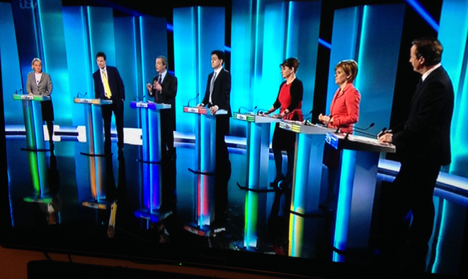
Listening to the TV debate
Dr Vinod Bhatt

Slide 2
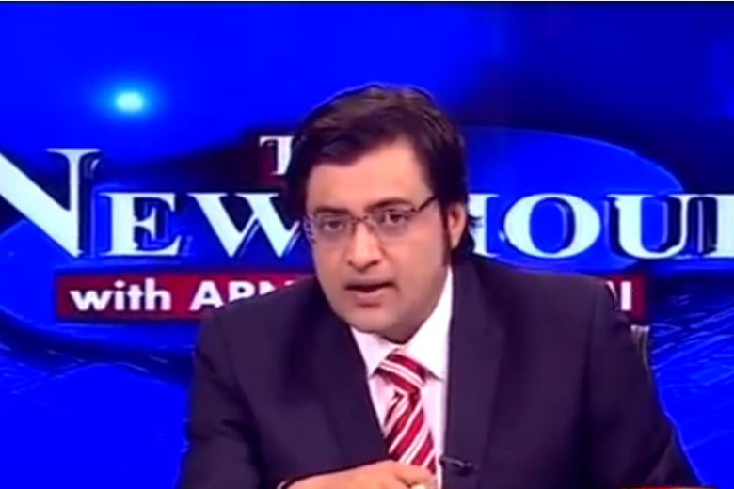
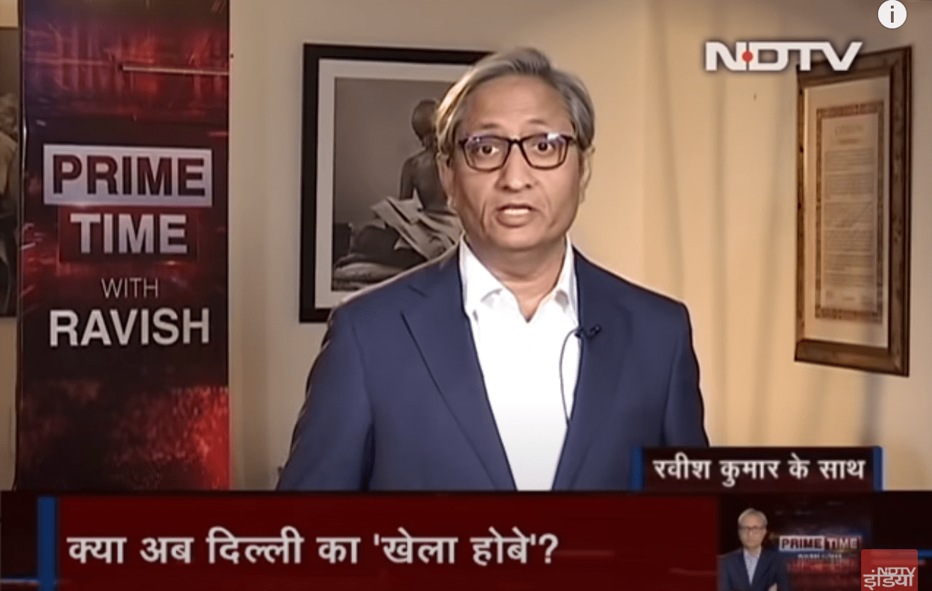
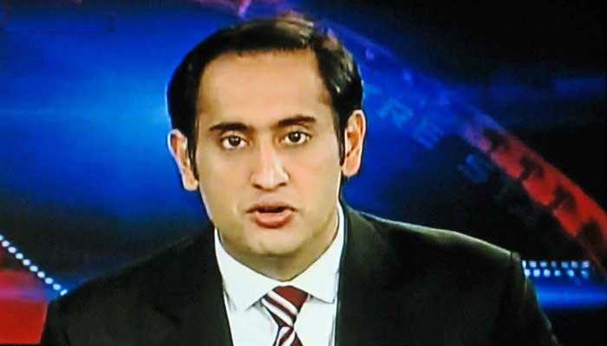
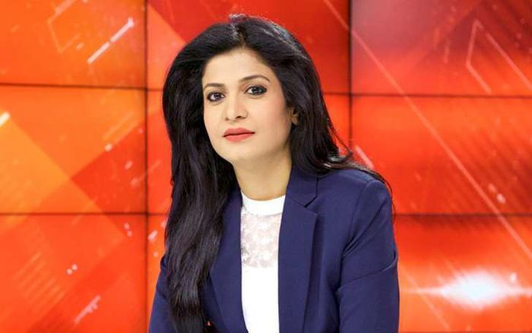
Some famous TV debate anchors
rahul kanwal

Slide 3
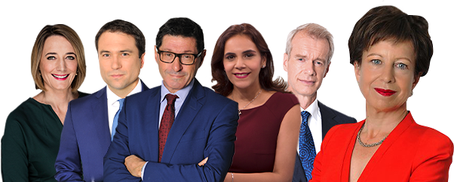
BBC news debate team

Slide 4
Topics for the TV debate
Debate on international issue
Debate on national issue
Debate on national policies
Debate on social issues
Debate on current issue
Debate on national policies
Debate on political issue
Debate on public interest
Etc.

Slide 5
Pre requisites
Listen the important elements of a debate, such as taking a stand on an issue.
Listen the importance of the debate.
identify information about a candidate from a televised debate.
Listen and determine important criteria for selecting a candidate.

Slide 6
Procedure of listening debate on TV
Listen how the introduction of the debate is given
Listen the body language of the anchor
Assertive
Aggressive
Calm and cool
Listen the body language of the participants
Listen how the arguments are made
Listen how the participants are giving their view points
Listen how the counter view points are made
Listen how the examples are supported the view point
Listen how the

Slide 7
During debate: point to highlight
Relate it with your existing knowledge
Relate it to the knowledge that you are going to gain
Listen how many relevant points are given
Listen how many irrelevant/ absurd points are given
Listen how the language is attempted
Listen if any obscene/ profane language is used
Evaluate whether the debate reached to a comprehensive conclusion

Slide 8
Recommended debates
https://www.youtube.com/watch?v=Rc-kwHE2ZGo
https://www.youtube.com/watch?v=DM90xYHE2-w
https://www.youtube.com/watch?v=8GS7EkHwy8A
https://www.youtube.com/watch?v=1WInOH76fJc
https://www.youtube.com/watch?v=WO6mRlL2tRY

